Slide 1
B2.1.4 Construct and use common
debugging techniques

Slide 2

Welcome to Debugging Techniques
Starter :
Turn to your partner and share one time you had to solve a problem step by step
Today you will learn essential debugging techniques to find and fix errors in your code
Learning Target: You will construct and use trace tables to debug programs effectively
Think about: What happens when your code doesn't work as expected?
Notes:
Image from: https://www.freepik.com/premium-photo/back-view-young-asian-man-sitting-desk-using-computer-programming-debugging-improving-binary-algorithm-code-workstation-by-focusing-monitor-blurring-people_37426837.htm

Slide 3

What is Debugging?
Debugging is the process of finding and fixing errors (bugs) in your code
Think-Pair-Share: Discuss with your partner what types of errors you've encountered in programming
Common error types: syntax errors, logic errors, runtime errors
Debugging helps ensure your program works correctly before testing
Essential skill for all programmers regardless of experience level
Notes:
Image from: https://www.freepik.com/premium-vector/programmer-characters-catch-bugs-debugging-process-programming-coding-create-app-application-development-testing-antivirus-software-websites-building-cartoon-people-vector-illustration_17020723.htm

Slide 4
Introduction to Trace Tables
Trace tables track variable values as your program executes line by line
They help you visualize what happens to data during program execution
Compass Points Activity: Move to corners based on your experience level
North: Expert (used trace tables before)
South: Beginner (never used them)
East: Intermediate (heard of them)
West: Curious (want to learn more)

Slide 5
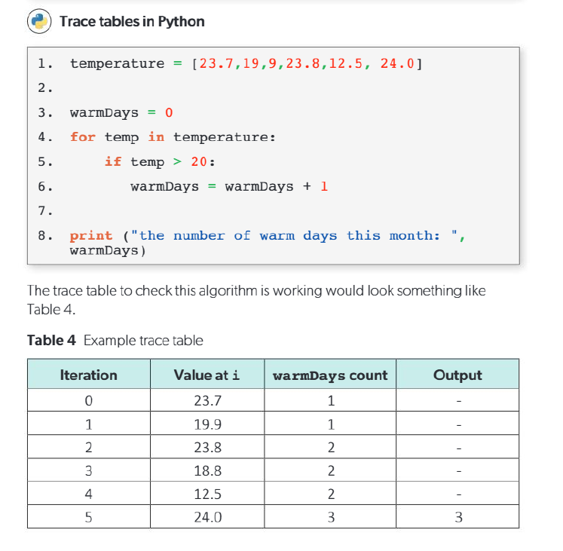

Slide 6
Basic Trace Table Structure
Create columns for each variable in your program
Add rows for each step of execution
Record initial values and changes as the program runs
Include line numbers or step numbers for reference
Back-to-Back, Face-to-Face: Partner A explains the structure, Partner B adds missing details

Slide 7
Trace table

Slide 8
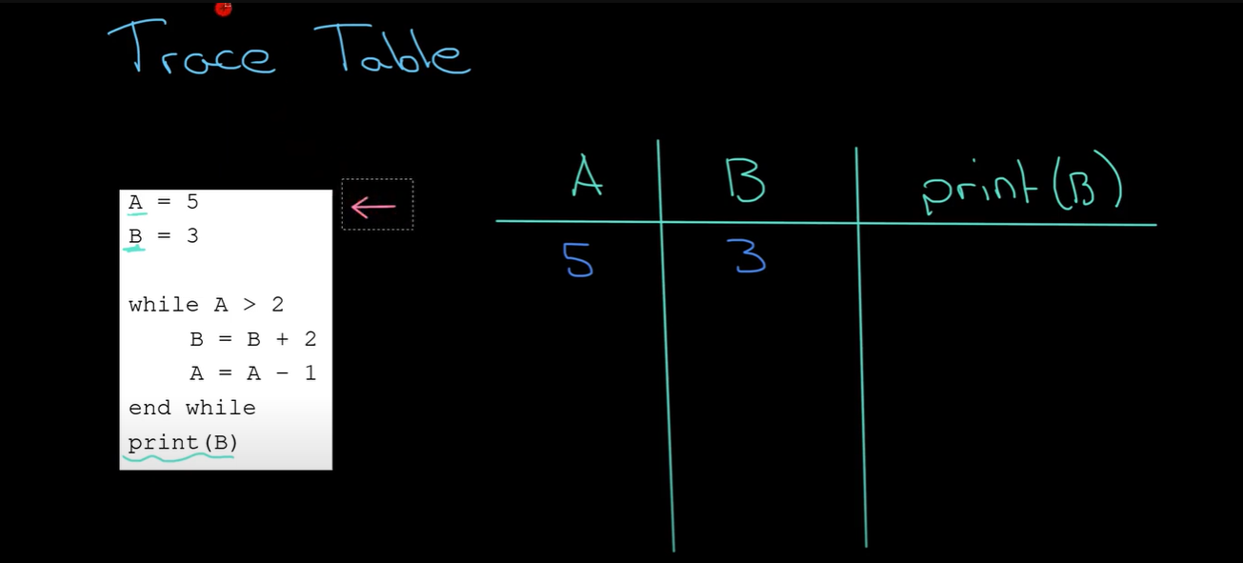

Slide 9
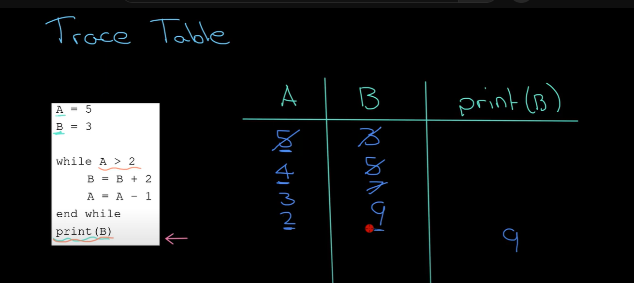

Slide 10
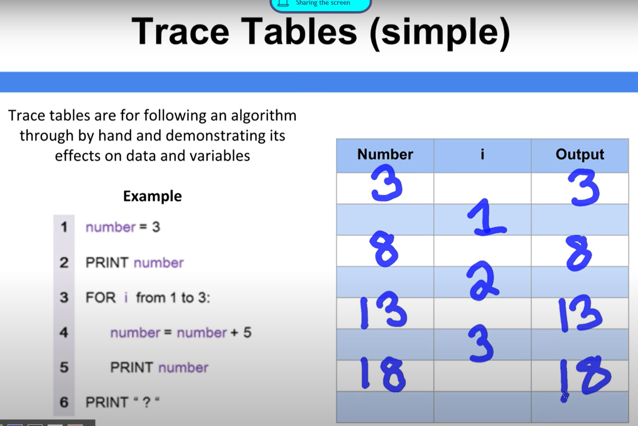

Slide 11
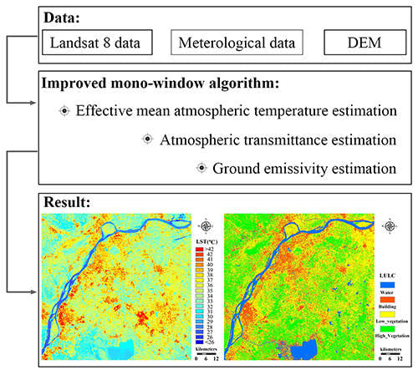
Worked Example: Counting Warm Days
Algorithm: Count days over 20°C from temperature data
Variables needed: temperature, count, day_number
Step through the algorithm together as a class
Watch how variables change with each iteration
Reflection Question: How does tracking variables help identify errors?
Notes:
Image from: https://www.mdpi.com/2072-4292/7/4/4268

Slide 12
Beginner Level: Simple Trace Table
Start with basic counting algorithm (3-4 variables maximum)
Use clear, simple data sets
Focus on understanding variable changes
Practice Activity: Complete a partially filled trace table
Learning Target Check-in: Can you identify when variables change?

Slide 13
Intermediate Level: Complex Logic
Add conditional statements and loops to trace tables
Include nested structures and multiple conditions
Track boolean variables and decision points
Challenge: Create your own trace table for a given algorithm
Think-Pair-Share: Compare your trace table with a partner's approach

Slide 14
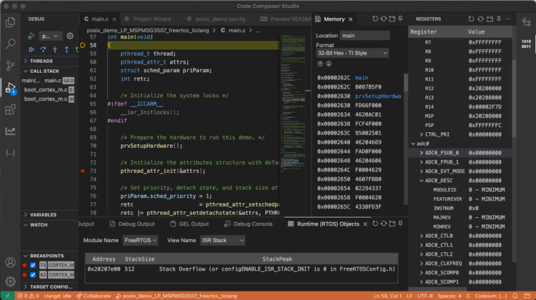
Advanced Level: Optimization and Efficiency
Use trace tables to identify inefficient code patterns
Analyze algorithm complexity through variable tracking
Debug recursive functions and complex data structures
Extension Task: Modify the algorithm and predict the trace table changes
Appreciations: Recognize creative debugging approaches from peers
Notes:
Image from: https://www.ti.com/tool/CCSTUDIO

Slide 15
Other Essential Debugging Techniques
Print statements: Output variable values at key points
Breakpoints: Pause execution to examine program state
Step-through debugging: Execute code line by line
Code review: Have others examine your code for errors
Compass Points: Which technique appeals to you most and why?

Slide 16

Putting It All Together
Closing Circle: Share one debugging technique you'll use in your next project
Exit Ticket: Rate your confidence with trace tables (1-5) and explain your reasoning
Remember: Debugging is a skill that improves with practice
Next steps: Apply these techniques to your internal assessment projects
Celebration: You now have powerful tools to solve programming problems!
Notes:
Image from: https://www.dreamstime.com/photos-images/people-problem.html

Slide 17
Practice Trace table

